Slide 1
Critique
A critique is a detailed analysis and assessment of something, esp. a literary works, artistic endeavors, and philosophical or political theory.
A critique can be a written or can be a verbal assessment of visual work.

Slide 2
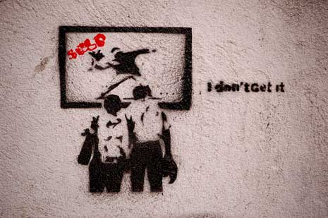

Slide 3
Critiquing our blogs and projects

Slide 4
The student explains the blog writing or project work by addressing his/her concepts, choices, compositional concerns, and overall personal view of the work created.

Slide 5
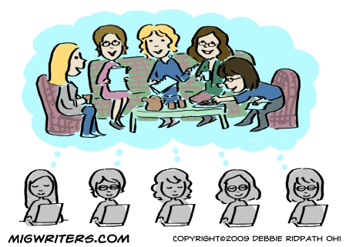
The peer group then asks questions of the student who made the work to better understand the intention of the artist and his/her work.

Slide 6
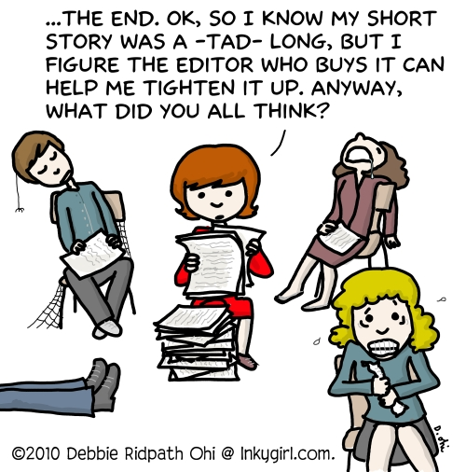
Tips for Constructive Critiquing
Tip #1: Edit, re-edit and Prepare before you present your work to others.
Don’t wait for them to “fix” it for you

Slide 7
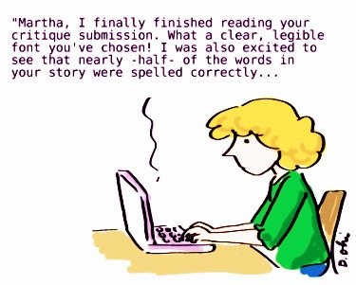
Tips for Constructive Critiquing
Tip #2: Always find something positive to say when you are critiquing.

Slide 8
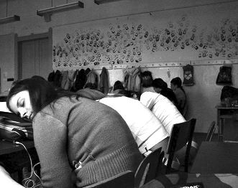
Tips for Constructive Critiquing
How do you engage the class and turn your peers’ attention from this to…
This?!!?

Slide 9
Stick with the main points!

Slide 10
Tips for Constructive Critiquing
Describe
Analyze
Interpret

Slide 11
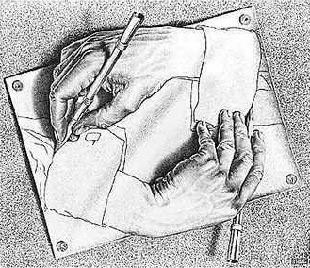

Slide 12
Critique
Using this critique method assists in activities found to promote Second Language Acquisition (SLA).
Interaction
Negotiation of Meaning
Integration of Skills
Speaking and Listening

